Slide 1
CES Fall Forum 2014
Performance Assessments,
the Second Time Around
Rick Lear
rick@envisionschools.org

Slide 2
How do you know your students are prepared to succeed in college, career, and life?
Notes:
An essential question as educators ......

Slide 3
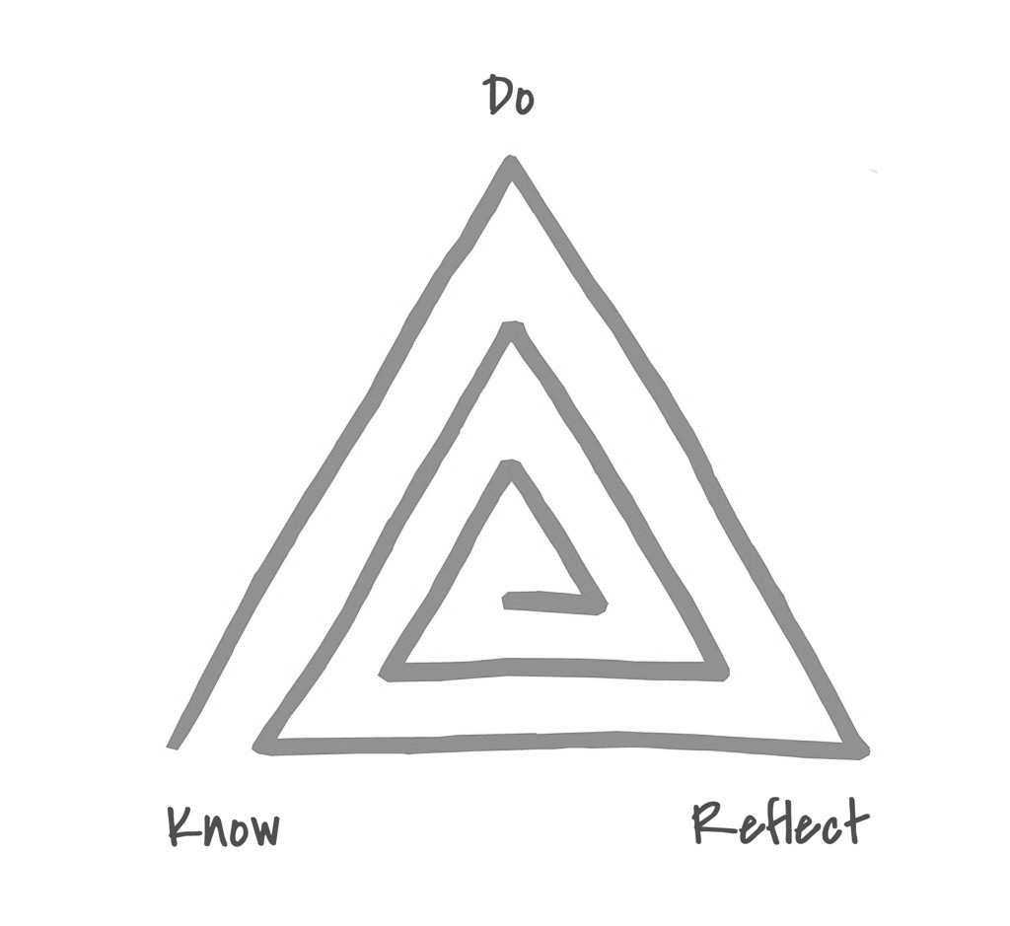
An Envision Graduate
Knower, a Doer, and a Reflecter.
Notes:
In order to be successful in college and beyond, Envision graduates are asked to go beyond content knowledge to develop critical competencies that we believe will prepare them for life outside of high school.
We have worked closely with Stanford to develop performance tasks and rubrics that are aligned to the Common Core standards as well as ask students to apply 21st century skills.

Slide 4
The Numbers
100%
>90%
>70% >90%
meet the course requirements to attend a
4 year public college in California.
attend 2 or 4 year college.
attend a 4-year college.
re-enroll in their 2nd year of college.
Notes:
Envision Schools have achieved these results through performance assessment.
We believe that success is not defined as students graduating from high school.
It does not even stop with college-going rates.
We believe that we must prepare students to enter college and to persist.
When our high school graduates graduate from college, then we have succeeded.

Slide 5
performance assessment: a baseline definition
What is Performance Assessment?
product or performance
application of targeted skill(s)

Slide 6
What is Performance Assessment?
In short, as the term is used in the literature:
An authentic performance assessment requires students to demonstrate skills and competencies which realistically represent those needed for success in the daily lives of adults.
Authentic tasks are worth repeating and practicing. They require students to apply what they know, not merely to recall or recognize information.
Finally, authentic tasks are those which are judged by criteria or standards similar to those used to evaluate the efforts of adults.
Performance Assessment, Wisc Education Association Council, Educational Issues Series, May, 1996

Slide 7
What is Performance Assessment?
“Performance assessment is assessment based on observation and judgment; we look at a performance or product and make a judgment as to its quality.”
— Rick Stiggins

Slide 8
What is Performance Assessment?
PA, or not PA?
In small groups, discuss which of the following you believe to be a performance assessment.
multiple-choice math quiz
an essay
a lab report
Chemistry AP Exam
a job interview
music audition
SAT multiple-choice question
textual analysis of People’s History
research paper on ancient Greek drama
student-written & performed tragedy in Greek style

Slide 9
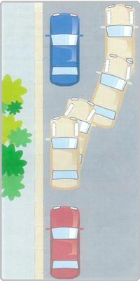
Test of a true performance assessment . . .
What is Performance Assessment?
before
during
after

Slide 10
Performance Assessment has deep CES roots
Links:
Consortium
QPA
1997
2006

Slide 11
Hewlett Foundation
Deeper Learning Competencies
Link to more detail
Master core academic content.
Students develop and draw from a baseline understanding of knowledge in an academic discipline and are able to transfer knowledge to other situations.
Think critically and solve complex problems. Students apply tools and techniques gleaned from core subjects to formulate and solve problems. These tools include data analysis, statistical reasoning, and scientific inquiry as well as creativity, nonlinear thinking, and persistence.
Work collaboratively.
Students cooperate to identify and create solutions to academic, social, vocational, and personal challenges.
Communicate effectively.
Students clearly organize their data, findings, and thoughts.
Learn how to learn.
Students monitor and direct their own learning.
Develop academic mindsets.
Students develop positive attitudes and beliefs about themselves as learners that increase their academic perseverance and prompt them to engage in productive academic behaviors. Students are committed to seeing work through to completion, meeting their goals, and doing quality work, and thus search for solutions to overcome obstacles.

Slide 12
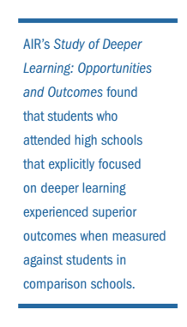
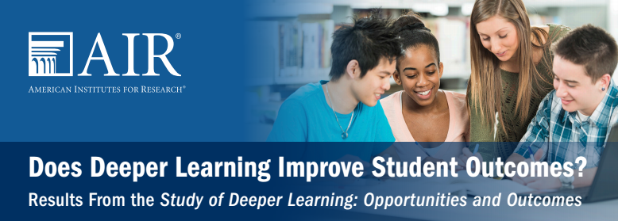
Research
Executive Summary of “Does Deeper Learning Improve Student Outcomes?”
AIR reports on Deeper Learning.

Slide 13
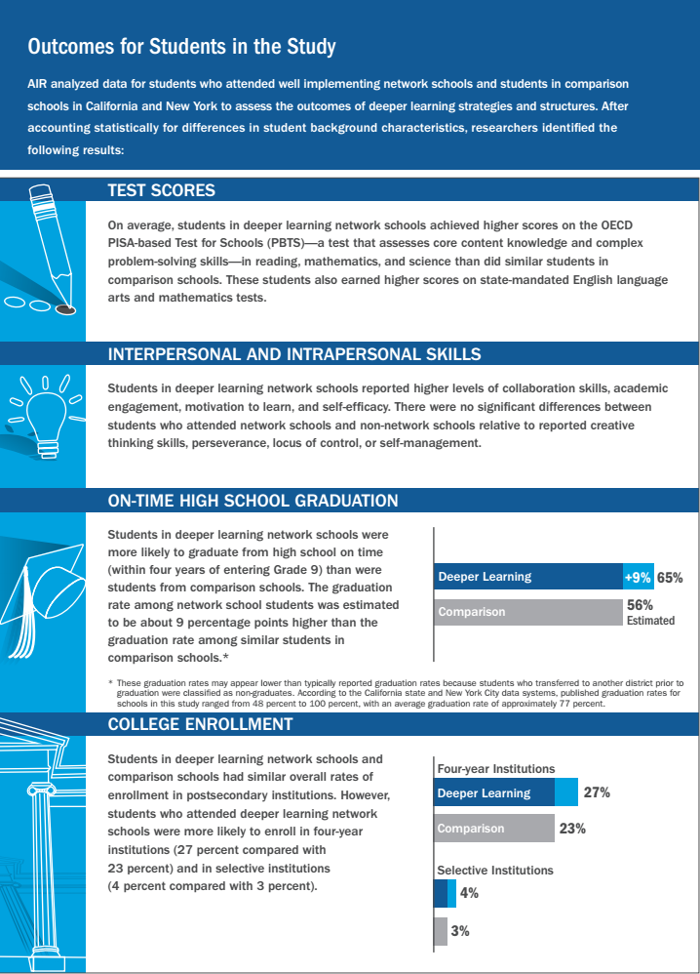
PISA-based test: core content knowledge and complex problem-solving skills in reading, math, science. Higher state ELA and math scores.
Reported higher levels of collaboration skills, academic engagement, motivation to learn, and self-efficacy.
More likely to graduate HS on time. Rate was about 9% higher than comparison schools.
More likely to enroll in 4-yr schools (4%);
slightly more likely to enroll in selective schools.

Slide 14
Deeper Learning
Student Assessment Initiative (DLSAI)
Envision Education
Asia Society
ConnectEd
New Tech Network
SCALE

Slide 15
Competencies and Skills
Content
College Success Portfolio
Leader-ship Skill
Reflection
Science, Social Studies, or English
Research
Leader-ship Skill
Reflection
Science, Math or Social Studies
Inquiry
Leadership Skills
Leader-ship Skill
English and/or Art/Digital Media
Creative Expression
Reflection
Collaborating Productively
Thinking Critically
Leader-ship Skill
Reflection
Math or English
Communicating Powerfully
Analysis
Completing Projects Efficiently
Leader-ship Skill
Reflection
WLE: Workplace Learning Experience
Research, Inquiry, Creative Expression, or Analysis

Slide 19
How the Graduation Performance System Works
Module & Task Implementation
Assessment and Scoring of Student Work
Teacher & Student Feedback and Reflection
Module & Task Design
GPS Performance Outcomes & Rubrics
Portfolio of Student Work
College Ready and Globally Competent Graduate
This is a continuous cycle that:
repeats across the curriculum
happens in school and in out-of-school time
drives improvement among teachers and students

Slide 21
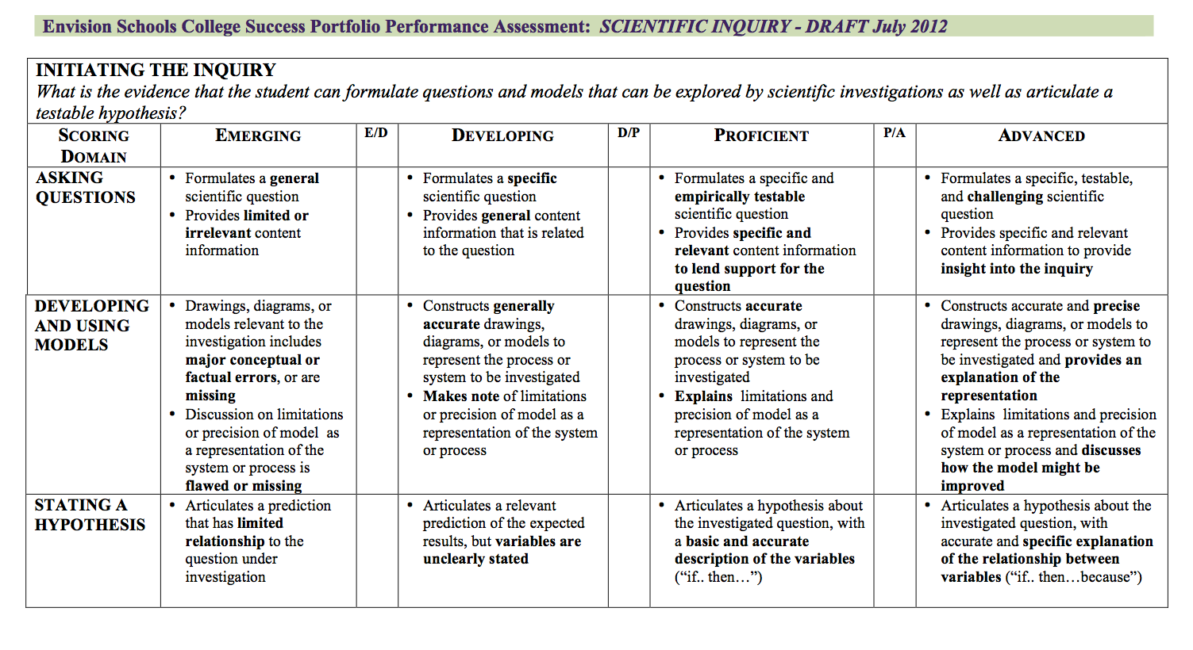
Rubrics

Slide 22
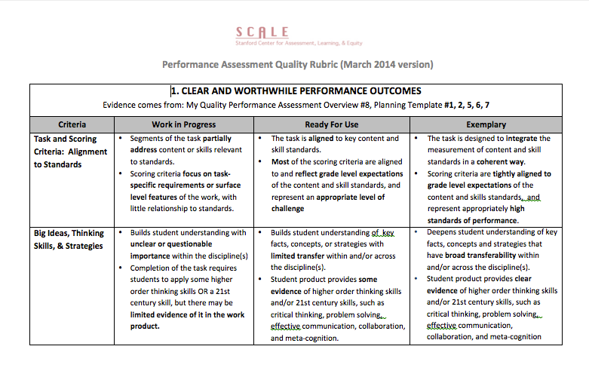
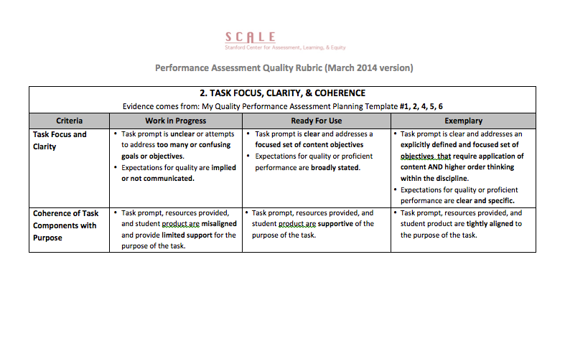
SCALE rubric
Performance Task Design Rubric
Criteria
Clear and worthwhile performance outcomes
Performance Assessment: Focus, Clarity, and Coherence
Student Engagement: Relevance and Authenticity
Student Engagement: Choice and Decision Making
Student Engagement: Accessibility xxxxxxxxxxxxxxxxx
Curriculum Connected
Opportunities for Self-Assessment, Peer and Teacher Feedback

Slide 23
Other resources:
William and Flora Hewlett Foundation on Deeper Learning
Teaching Channel has produced a Deeper Learning Video Series that provides a glimpse of Deeper Learning practices across the ten member organizations that comprise the Deeper Learning Community of Practice.
Deeper Learning Student Assessment Initiative
Envision Education
Asia Society
ConnectEd
New Tech Network
SCALE
rick@envisionschools.org

